Slide 1
Secure Instant Messaging System Design

Slide 2
ARCHITECTURE:
Server:
Authenticates client on login based on User’s password.
Stores public key of every client.
If User1 wants to talk to User2, Server provides the public key of User2 to User1.
Client:
Fetches public key of other users from Server
Communicates with other clients

Slide 3
Protocol Notations:
PKU1: Public key of User1
PKU2: Public key of User2
pass: Password of User1
g : generator
R1: Random number
R2: Random number
IP : IP address of source
sec: Secret know only by Server

Slide 4
Protocol that we would implement:

Slide 5
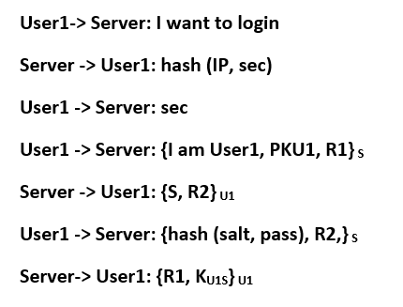
Protocol Phase 1: User authenticates to Server on login
Here server store the value of g, salt. computation of g^hash(salt, pass) and username.
Password verifier is g^hash(salt, pass) and it is indexed by the username.
When user initiates the connection it shares it’s public key which is stored by server for that session.
Here we will be doing proof of work by making user1 calculate the secret which in turn will save us from DOS attack.
In the end server is storing a session key for user1 and also giving it to user1 for future communication.
Here we are doing this proof of work every time but in idle implementation we will start this mode only when we our system detects a heavy traffic.

Slide 6
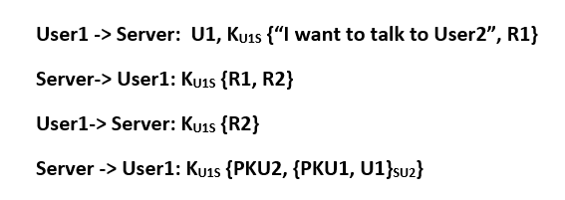
Protocol Phase 2: User1 requests public key of User2 from Server:
Server has a shared key with every user.
If client doesn’t receive a correct response to it’s challenge it doesn’t proceed far.
After the third step, if server receives the correct response to its challenge, it continues to the next step, else breaks connection.
Server provides user1 with a token that it can use to talk to user2 i.e. {PKU1, U1}su2 here su2 is the secret key between server and user2.

Slide 7
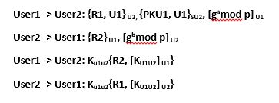
Protocol Phase 3: User1 connects to User2 using token generated by Server
User1 initiates communication with user2 by using token generated by server.
After the second step, user1 and user2 are able to generate a shared session key.
Both user verifies the shared key they have by sending them over and also signing them by their private key.

Slide 8
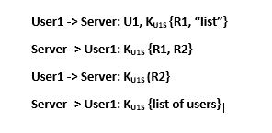
List command:
Here the steps are similar to phase 2 where User ask for list of current login users.
In second packet server authenticates itself than sends challenge for user.
Once user authenticates itself server sends the list of user.

Slide 9
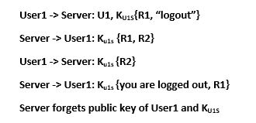
Logout command:
Here user1 sends a logout request and a challenge.
Than server authenticates itself and also sends it’s challenge to server.
Once it authenticates the server the server deletes the public key and session key. It also send the confirmation. In our implementation we will wait for reply for some seconds and if we don’t get the reply from server we will warn user about logout process not complete but will shut down the client.
In ideal case the client will initiate the logout process again if that is the case.

Slide 10
Ideal Protocol:

Slide 11
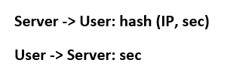
DoS Protection is done at every step as follows:
This is a proof of work concept which we will use when ever our server detects heavy traffic.

Slide 12
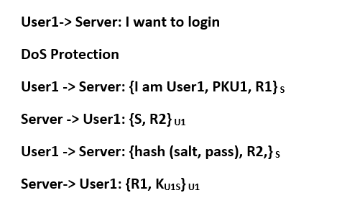
Protocol Phase 1: User authenticates to Server on login
In ideal case the DoS protection will start only when server detects the heavy traffic.
In our implementation it is done every time when user logins in.

Slide 13
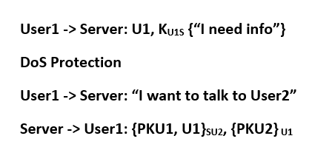
Protocol Phase 2: User1 requests public key of User2 from Server:
Here the protocol is same as we are going to implement. The only added protection is the DOS protection as previously discussed.

Slide 14
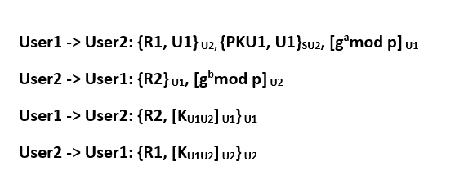
Protocol Phase 3: User1 connects to User2 using token generated by Server
In this phase the protocol is same as we are going to implement.

Slide 15
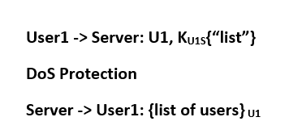
List command:
Here the protocol is same as we are going to implement. The only added protection is the DOS protection as previously discussed.

Slide 16
Logout command:
Here the protocol is same as we are going to implement. The only added protection is the DOS protection as previously discussed.
Also if user doesn’t get the confirmation of logout from server it will re initiate the whole process of logout which is not the case in our implementation.

Slide 17
Network Security Services:
Confidentiality:
Incorporate Pretty Good Privacy where we will use combination of RSA 2048 and AES 256 for encryption in CTR mode.
Integrity/Authentication:
HMAC
Non-repudiation:
Diffie Hellman keys signed with private key of users
Audit:
Server will keep a log of requests which will consist of the timestamp and the name of user who requests public key.

Slide 18
Issues and Resolutions:
ISSUE | RESOLUTION
Weak Password Protection | Password verifier step in the login stage addresses this issue.
Resistance to DoS attacks | The client has to provide proof of work before acquiring resources.
Perfect Forward Secrecy | Each session would have its own set of Diffie Hellman exponents and shared key and they would be forgotten after the session ends.
Prevent server from decrypting communication between users | Server does not have the private key of the users, which is needed to decrypt messages, hence server cannot read messages.

Slide 19
Thank you!

